Slide 1
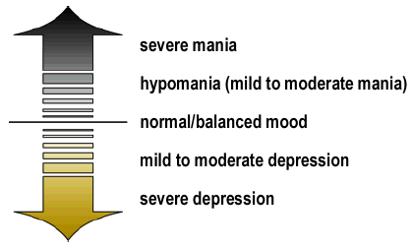
Bipolar Disorder
Formerly known as manic-depressive disorder, bipolar disorder is a mental abnormality involving swings of mood from mania to depression.
A strong genetic component is well established, although the exact genes involved are not known.
1% of the population has bipolar attacks, having an identical twin with the problem inflates a person’s chances to about 70%

Slide 2
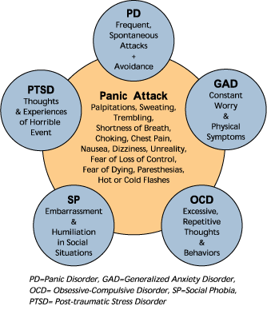
Anxiety Disorders
Everyone has experienced some level of anxiety in their life. For some people, a spider, or a tall ladder are enough to send chills down the spine.
Psychopathology anxiety is far more sever than the anxiety associated with normal life challenges.

Slide 3
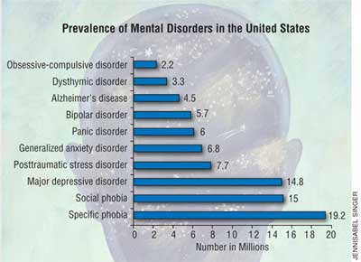
Prevalence of Mental Disorders
=Anxiety Disorder

Slide 4
Why do you think Anxiety Disorders are the most prevalent of all mental disorders in the United States?
How would you explain the most common mental illnesses?

Slide 5
PTSD
Post Traumatic Stress Disorder dates back to 6 B.C. where reports of battlefield stress had an adverse affect on soldiers.
In the past PTSD has been referred to as railway spine, shell shock, battle fatigue, traumatic war neurosis, or post-traumatic stress syndrome.

Slide 6
PTSD
Listen to:
1.NPR: “Ending Nightmares Caused by PTSD”
2. NPR: “PTSD Isn’t Just a War Wound; Teens Suffer Too”
Apply vocabulary, answer questions, compare and contrast experiences

Slide 7
PTSD
Listen to:
“This American Life”
Go to “Radio Archive”
Click on “Doppelgangers”
Go to “Act Two: In Country, In City”

Slide 8
PTSD & Homeless Vets
According to the “The National Coalition for the Homeless”:
40% of homeless men are veterans, although veterans comprise only 34% of the general adult male population.
45% of homeless vets suffer from mental illness, and half have substance abuse problems
Post-traumatic stress disorder (PTSD) and traumatic brain injuries are more prevalent among Iraq and Afghanistan vets, leading to drug abuse, mental illness and suicide.

Slide 9
Generalized Anxiety Disorder
Generalized anxiety disorder is a psychological problem characterized by persistent and pervasive feelings of anxiety, without any external cause.
May experience times when your worries don't completely consume you, but you still feel rather anxious
May feel on edge about many or all aspects of your life
May have a general sense that something bad is about to happen, even when there's no apparent danger.
May not remember when you last felt relaxed or at ease.
GAD often begins at an early age, and the signs and symptoms may develop slowly.

Slide 10
Panic Disorder
Panic disorder is a disturbance marked by sudden and severe anxiety attacks that have no obvious connections with events in the person’s life.
Usually free of anxiety between panic attacks
Panic attack symptoms:
* Rapid heart rate
* Sweating
* Trembling
* Shortness of breath
* Hyperventilation
* Chills
* Hot flashes
* Nausea
* Abdominal cramping
* Chest pain
* Headache
* Dizziness
* Faintness
* Trouble swallowing
* A sense of doom

Slide 11
Panic Disorder
Many people who suffer from panic disorder also have agoraphobia. A condition which involves panic that develops when people find themselves in situations from which they cannot easily escape: crowed places, open spaces, etc.
Occurs in about 2% of people and affects women more than men.

Slide 12
Phobic Disorders
In contrast to panic disorder, phobias involve persistent and irrational fear associated with a specific object, activity or situation.
While many of us have fears, or dislikes of specific objects or situations, these only become psychopathology when they have a cause substantial disruptions in our lives.
Coulrophobia

Slide 13
Phobias-Irrational Fears
Acrophobia: Heights
Claustrophobia: Enclosed spaces
Hematophobia: Blood
Gephyrophobia: Crossing a bridge
Kenophobia: Empty rooms
Cynophobia: Dogs
Coulrophobia- clowns
Aerophobia: Flying
Entomophobia: Insects
Gamophobia: Marriage
Ophdophobia: Snakes
Xenophobia: Strangers
Melissophobia: Bees

Slide 14
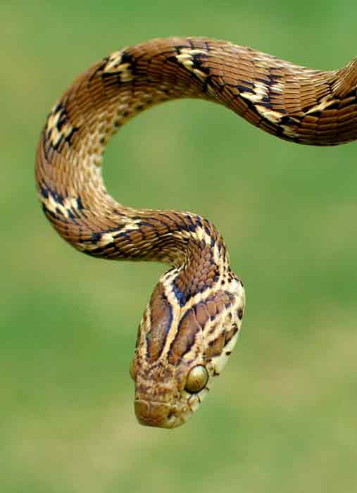
Preparedness Hypothesis
This theory suggests that we carry an innate biological tendency, acquired through natural selection, to respond quickly and automatically to stimuli that posed a survival threat to our ancestors.
May explain why we develop phobias for snakes and lightening much more easily than automobiles and electrical outlets

Slide 15
Obsessive-Compulsive Disorder
OCD is a condition characterized by patterns of persistent, unwanted thoughts and behaviors.
The obsessive component consists of thoughts, images or impulses that recur or persist despite a person’s efforts to suppress them.

Slide 16
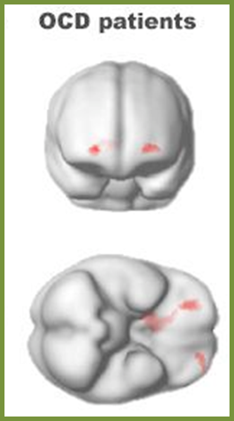
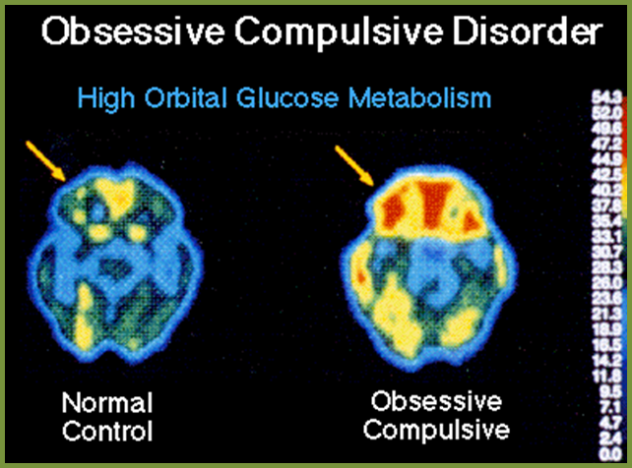
OCD Brains

Slide 17
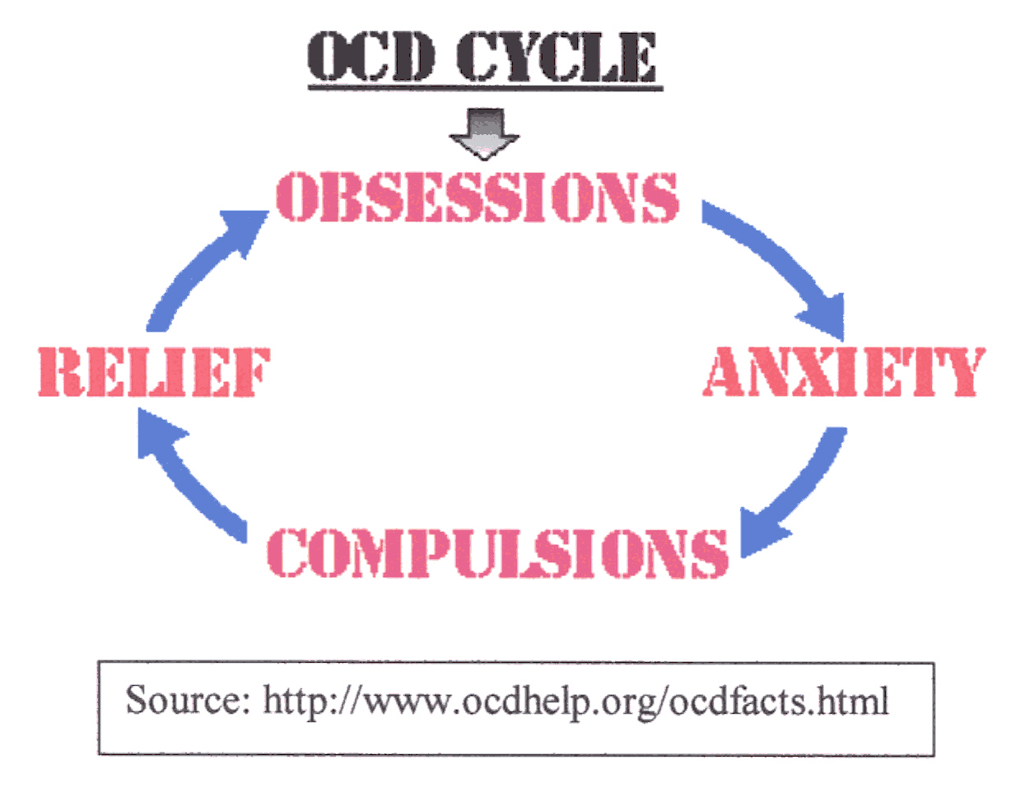
Obsessive-Compulsive Disorder
The compulsive component are repetitive, purposeful acts performed according to certain private “rules,” in response to an obsession.

Slide 18
Obsessive Compulsive Disorder Many characters on TV and in movies have OCD: Jack Nicolson in As Good As It Gets; Monica on Friends; Monk Others?

Slide 19
Obsessive-Compulsive Disorder
When they are calm, people with obsessive-compulsive disorder view their compulsions as senseless. However, when anxiety arises, they cannot resist performing the compulsive behavior rituals to relieve tension.
OCD has a tendency to run in families
A clear genetic connection
Environment seems to play a factor
Behavioral therapy helps many OCD sufferers

Slide 20
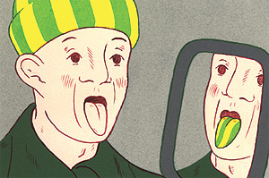
Somatoform Disorders
Somatoform disorders are psychological problems appearing in the form of bodily symptoms or physical complaints such as weakness or excessive worry about disease.
Conversion Disorder: A disorder marked by paralysis, weakness or loss of sensation but with no discernable physical cause.
Hypochondriasis: A disorder involving excessive worry about health and disease.
How a hypochondriac might see himself

Slide 21
Glove Anesthesia
A conversion disorder in which a person can’t feel their hand (B).
Neurologically this is impossible because the sensory nerves of the hand and arm are organized as shown in (A) rather than (B).

Slide 22
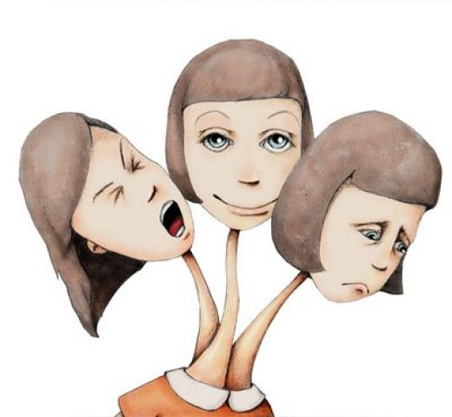
Dissociative Disorders
Dissociative disorders are a group of pathologies involving the “fragmentation” of the personality, in which some parts of the personality have become detached from other parts.

Slide 23
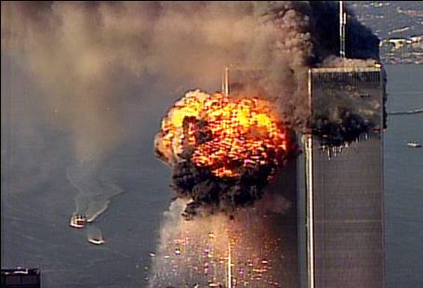
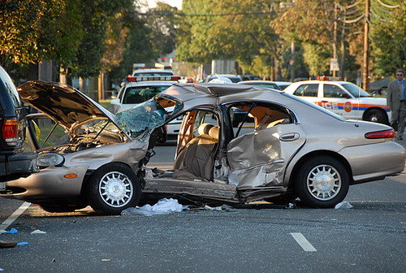
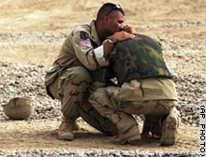
Dissociative Disorders
Dissociative Amnesia: A psychologically induced loss of memory for personal information, like one’s identity.
Usually the result of a stressful situation, it is often associated with Post Traumatic Stress Disorder (PTSD).

Slide 24
PTSD
Post Traumatic Stress Disorder dates back to 6 B.C. where reports of battlefield stress had an adverse affect on soldiers.
In the past PTSD has been referred to as railway spine, shell shock, battle fatigue, traumatic war neurosis, or post-traumatic stress syndrome.
Today treatment involves therapy and anti-anxiety drugs. During WWI treatment looked much different:
Shell Shock/Shock Therapy
New PTSD Therapy

Slide 25
PTSD
Listen to:
1.NPR: “Ending Nightmares Caused by PTSD”
2. NPR: “PTSD Isn’t Just a War Wound; Teens Suffer Too”
Apply vocabulary, answer questions, compare and contrast experiences

Slide 26
Dissociative Fugue
Dissociative fugue is a combination of fugue, or “flight, and amnesia. Sufferers not only suffer from a lost sense of identity, they also flee their homes, jobs and families.
While most episodes last only a few hours or days, it can last longer.
Heavy use of alcohol may predispose a person to dissociative fugue. While this suggest that some brain impairment may be involved, no specific cause has been identified.

Slide 27
Dissociative Fuge
The DSM-IV-TRlists four criteria for diagnosing dissociative fugue:
Unexplained/ unexpected travel from a person's usual place of living along with partial or complete amnesia.
Uncertainty and confusion about one's identity, or in rare instances, the adoption of a new identity.
The flight and amnesia that characterize the fugue are not related exclusively to DID, nor is it the result of substance abuse or a physical illness.
An episode must result in distress or impairment severe enough to interfere with the ability of the patient to function in social, work or home settings.

Slide 28
Depersonalization Disorder
Depersonalization disorder is an abnormality involving the sensation that mind and body have separated.
Often times sufferers explain episodes as out of body experiences.
Like all of the other dissociative disorders, depersonalization disorder occurs far more frequently following a prolonged period of stress or a traumatic event.

Slide 29
Dissociative Identity Disorder
Once called multiple personality disorder, dissociative identity disorder is a condition where an individual displays multiple identities or personalities.
Experts say this disorder appears first in childhood and may be a defensive response to abusive situations or terrifying events.
Most of the emerging personalities contrast in some significant way with the original self.
Fight Club is a movie about a character with sever DID.

Slide 30
Schizophrenia
Schizophrenia is a psychological disorder involving distortions in thoughts, perceptions and/or emotions.
This is the disorder people are referring to when they use terms like “madness,” “psychosis,” or “insanity.”

Slide 31
What Does it Look Like
For sufferers of schizophrenia, the mind can be twisted in terrible ways.
May become bleak and devoid of meaning
Can become very overwhelming and filled with stimuli, hallucinations and delusions.
In schizophrenia, emotions become blunted, thoughts turn bizarre, and language takes a strange turn. Take the following for example:

Slide 32
Sample Speech From Schizophrenic Patient
The lion will have to change from dogs into cats until I can meet my father and mother and we dispart some rats. I live on the front of Whitton’s head. You have to work hard if you don’t want to get into bed…It’s all over for a squab true tray and there ain’t no squabs, there ain’t no men, there ain’t no music, there ain’t nothing besides my mother and my father who stand along upon the Island of Capri where is no ice. Well it’s my suitcase sir. (Roger, 1982)

Slide 33
Prevalence of Schizophrenia
One out of every 100 Americans, 2 million people over the age of 18-will be affected.
For men, schizophrenia usually shows up before age 25, and between the ages of 25 and 40 for women.
Currently, schizophrenia is the diagnosis for over 40% of patients in public mental hospitals. This may be due to the fact that there is no cure, and often times patients will need need therapy for the remainder of their lives.

Slide 34
Genetics and the Risk of Schizophrenia

Slide 35
5 Major Types of Schizophrenia
Disorganized type: typical image of mental illness with incoherent speech, hallucinations, delusions and odd behaviors
Catatonic type: a range of motor dysfunctions
Stupor: long periods of coma like, motionless state
Excitement: agitated and hyperactive
Paranoid type: delusions and hallucinations but no catatonic symptoms and none of the incoherence of disorganized type
Undifferentiated type: a catchall term for schizophrenia symptoms that are erratic and do not it into one of the other categories, but are clear symptoms of the disorder
Residual type: the diagnosis for individuals who have suffered from schizophrenia, but have no major symptoms at the time

Slide 36
Schizophrenia
Subtypes of Schizophrenia
Paranoid: Preoccupation with delusions or hallucinations
Disorganized: Disorganized speech or behavior, or flat or inappropriate
emotion
Catatonic: Immobility (or excessive, purposeless movement),
extreme negativism, and/or parrotlike repeating of
another’s speech or movements
Undifferentiated Schizophrenia symptoms without fitting one of the
or residual: above types

Slide 37
Positive and Negative Categories
Often times, researchers now simply characterize symptoms of schizophrenia into positive and negative categories.
Positive symptoms refer to active process such as delusions, and hallucinations.
Negative symptoms refer to passive processes like social withdrawal.

Slide 38
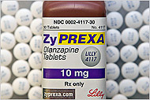
Causes of Schizophrenia
Freud originally thought schizophrenia was a result of defective parenting or repressed childhood trauma.
Impact of Drugs
Major tranquilizers which inhibit dopamine, can suppress the symptoms of schizophrenia
Drugs that provide excess dopamine can cause schizophrenic type behaviors in healthy people.

Slide 39
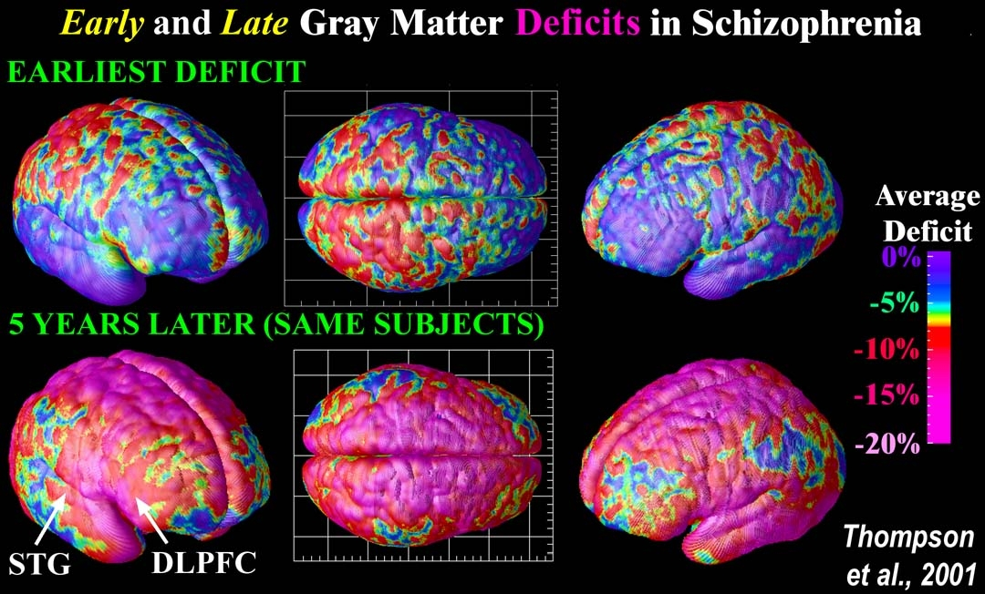
Causes of Schizophrenia
Loss of grey matter: Magnetic resonance images (MRI scanswere created after repeatedly scanning 12 schizophrenia subjects over five years, and comparing them with 12 healthy controls, scanned at the same ages and intervals.
Severe loss of gray matter is indicated by red and pink colors, while stable regions are in blue.
STG =superior temporal gyrus
DLPFC =dorsolateral prefrontal cortex.

Slide 40
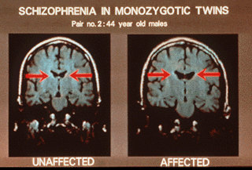
Causes of Schizophrenia
While the exact cause of the disorder still remains somewhat of a mystery, there is very strong evidence that it has a genetic link.
People who have an identical twin who suffers from schizophrenia have a 50% chance of suffering from the disorder too, even if they were raised in separate environments.
Similarly, a child with one parent suffering from schizophrenia has a 13% chance of developing the disorder, but a child of two parents with the disorder has a 46% chance of developing schizophrenia.

Slide 41
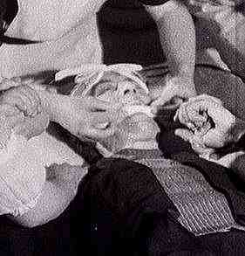
Schizophrenia Treatments
Much like the treatment for all psychological disorders, the treatment of schizophrenia has come a long way:
Lobotomies
Insulin Shock Therapy
Current treatment for schizophrenia is usually a combination of therapy and medication:
Schizophrenia Medication

Slide 42
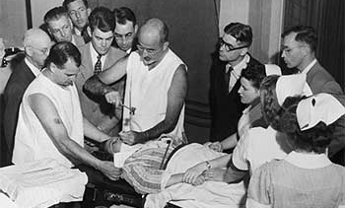
Lobotomies
One of the earliest treatments were lobotomies. This procedure consisted of cutting the connections to and from, or simply destroying, the prefrontal cortex.

Slide 43
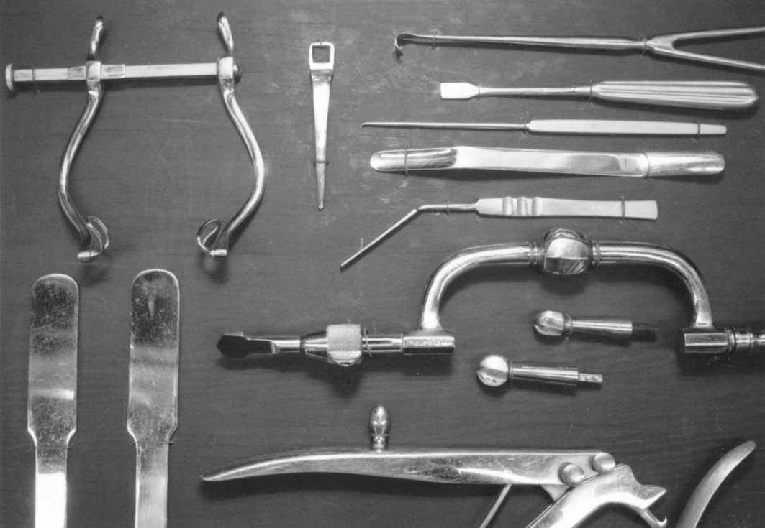
The Process
Doctors would access the frontal lobes through the eye sockets, instead of through drilled holes in the scalp. In 1945, he took an ice pick from his own kitchen and began to test the new surgical technique on cadavers.

Slide 44
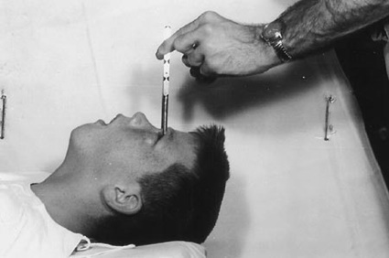
The Process
The technique involved lifting the upper eyelid and placing the point of a thin surgical instrument under the eyelid and against the top of the eye socket.
A hammer was used to drive the pick through the bone, into the brain. It was then moved from side to side, severing nerve fibers connecting the frontal lobes to the thalamus.

Slide 45
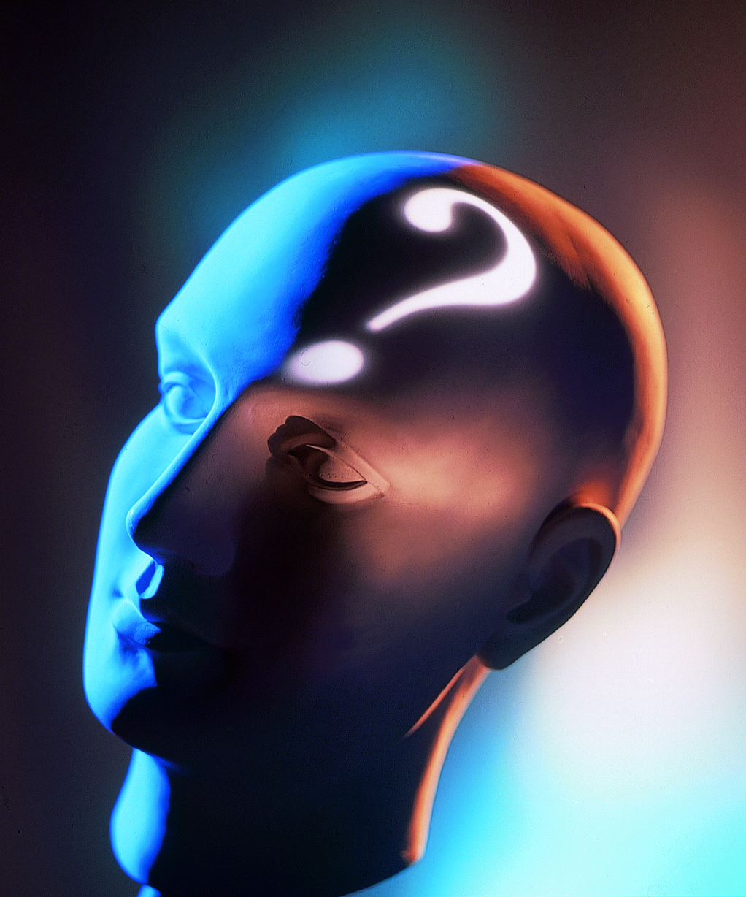
Other Types of Disorders
Most people get stuck thinking about depression and schizophrenia when they think about psychological disorders. In reality there are far more. Some of the more common, and more studied disorders are:
Eating Disorders:
Personality Disorders:
Developmental Disorders:

Slide 46
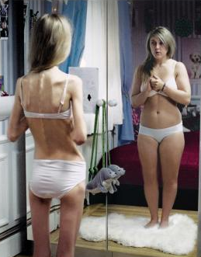
Eating Disorders
Of the eating disorders that exist, two are most prevalent and most studied:
Anorexia nervosa: an eating disorder that causes a persistent loss of appetite that endangers an individuals health
Stems from emotional or psychological reasons rather than natural causes
Usually a distorted view of oneself
1% of population affected
3.4% with partial syndrome anorexia

Slide 47
Eating Disorders
The other common eating disorder is bulimia nervosa.
Bulimia Nervosa: An eating disorder characterized by binges and purges
Induced vomiting, or laxatives
.6% of population affected with bulimia
Up to 4.2% of females

Slide 48
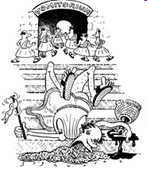
The History of Bulimia-Nervosa
It was believed that the ancient Romans used a vomitorium to rid themselves of food.
Bulimia was not established as a psychological disorder until the late 1970’s.
95-85% of cases of anorexia/bulimia are women in the US (National Institute of Mental Health)

Slide 49
Personality Disorders
Personality disorders are conditions involving a chronic, pervasive, inflexible and maladaptive pattern of thinking, emotion, social relationships or impulse control
Narcissistic Personality Disorder: Grandiose sense of self importance and preoccupation with fantasies of success
Antisocial Personality Disorder: Longstanding pattern of irresponsible behavior indicating lack of conscience and responsibility towards others.
Borderline Personality Disorder: Unstable and given to extreme impulses without clear reasoning.

Slide 50
Development Disorders
Developmental disorders are a group of disorders that can appear at any age, but most commonly show signs during childhood.
Autism: Marked by disabilities in language, social interaction and the inability to understand another person’s state of mind
1 in 500 children; recent increase in cases
Dyslexia: A reading disorder where letters words and numbers are perceived out of order, upside down or completely incomprehensible
True account of dyslexia

